Slide 1


WELCOME
30th Annual
Convention & Trade Show

Slide 2

#NARPM2018

Slide 3
UNDERSTANDING HVAC BASICS
ZACH HOWELL
APARTMENT MAINTENANCE INSTITUTE

Slide 4

TERMINOLOGY
WHAT YOU NEED TO KNOW
MAINTENANCE
TECHNICALLY SPEAKING

Slide 5
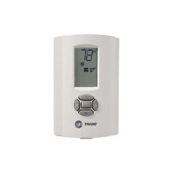
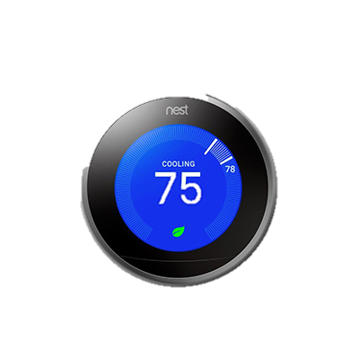
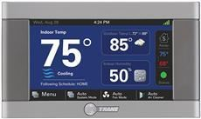
Thermostat
The thermostat is usually the most visible part of your HVAC system. Set on a prominent, easily accessible wall, it may be either programmed in advance or set manually to keep the home at a desired temperature. When the ambient temperature becomes too cold or too hot, the thermostat will trigger the heat exchanger or the evaporator coil-condensing unit combo to begin circulating warmed or cooled air as needed.

Slide 6
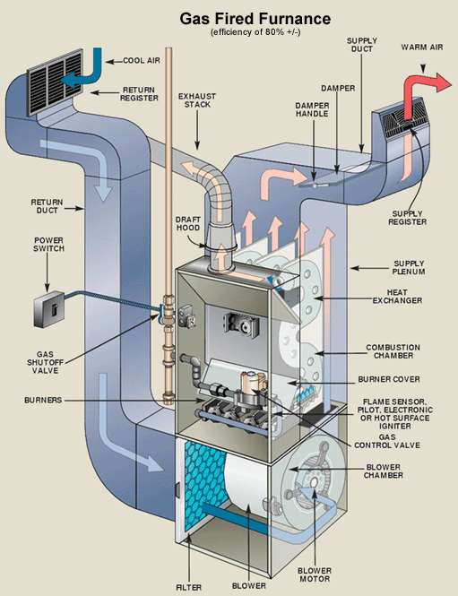
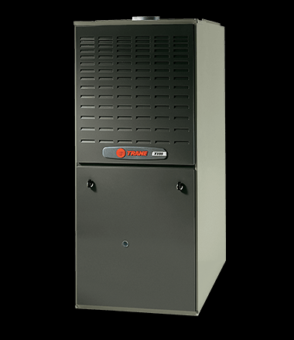
The furnace is the key component of your HVAC system. It's also the largest, requiring substantial space -- typically in the cellar, your finished basement, the attic, or a special closet designed for that purpose. Its function is to heat a supply of air which is to be distributed to various rooms of your home via the HVAC. This heating process is accomplished using one of four possible heat sources -- combustion (burning natural gas, oil, coal, or propane), electric resistance, heat pump, or solar energy collected on site.
Furnace

Slide 7
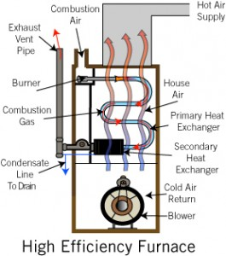
Heat exchanger
The heat exchanger is found inside your furnace unit's housing. This component switches on when the furnace is activated by thermostat to produce warmer temperatures in winter. The heat exchanger pulls in cool air, heats it, and circulates the resulting heated air via your ducts and out through the vents.

Slide 8
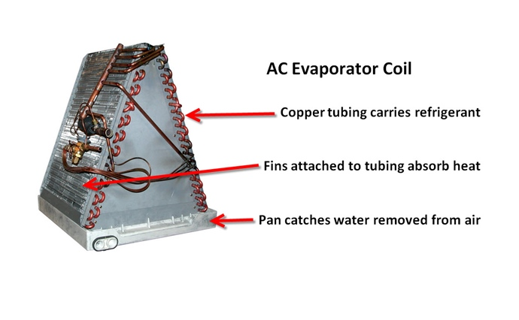
The evaporator coil has an opposite role to the heat exchanger; it acts to cool the air when your thermostat is set to lower temperatures in summer. Located in a metal enclosure on the furnace's exterior, to the top or side, the evaporator coil works similarly to an automobile radiator to produce cool air, which is then circulated through the ductwork.
Evaporator coil

Slide 9
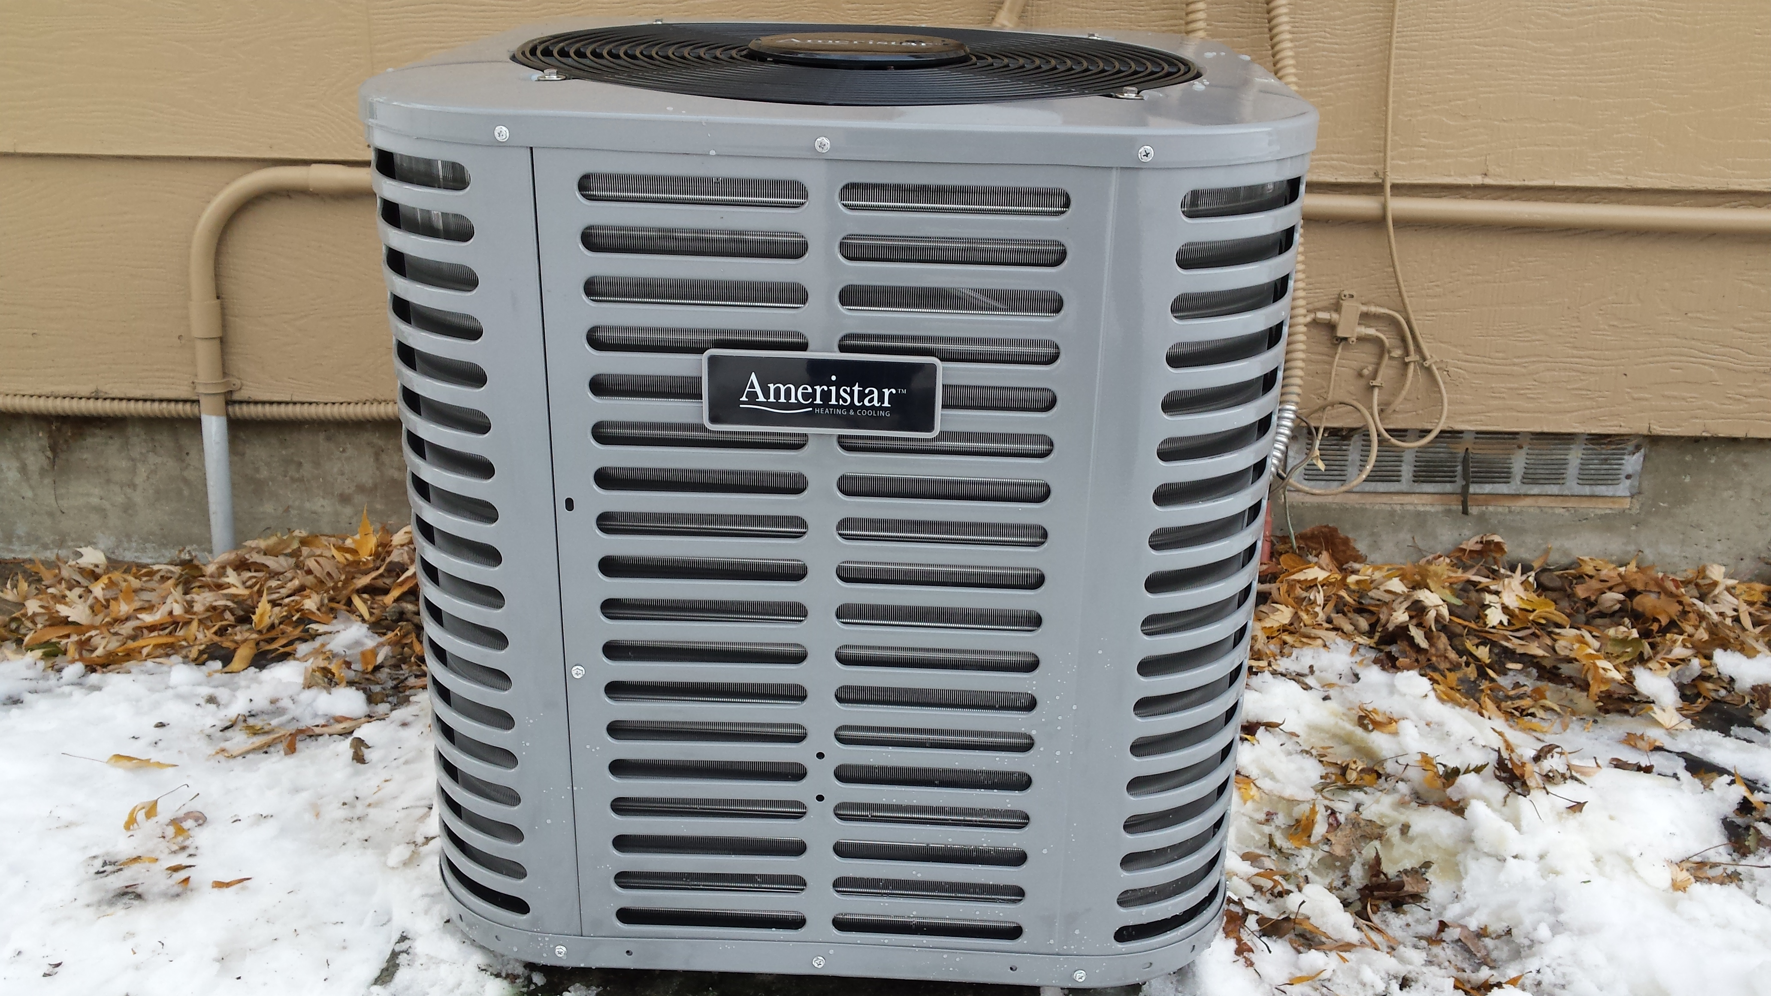
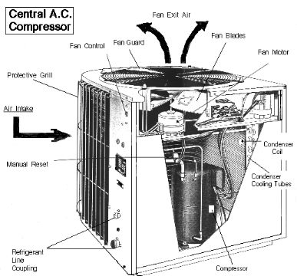
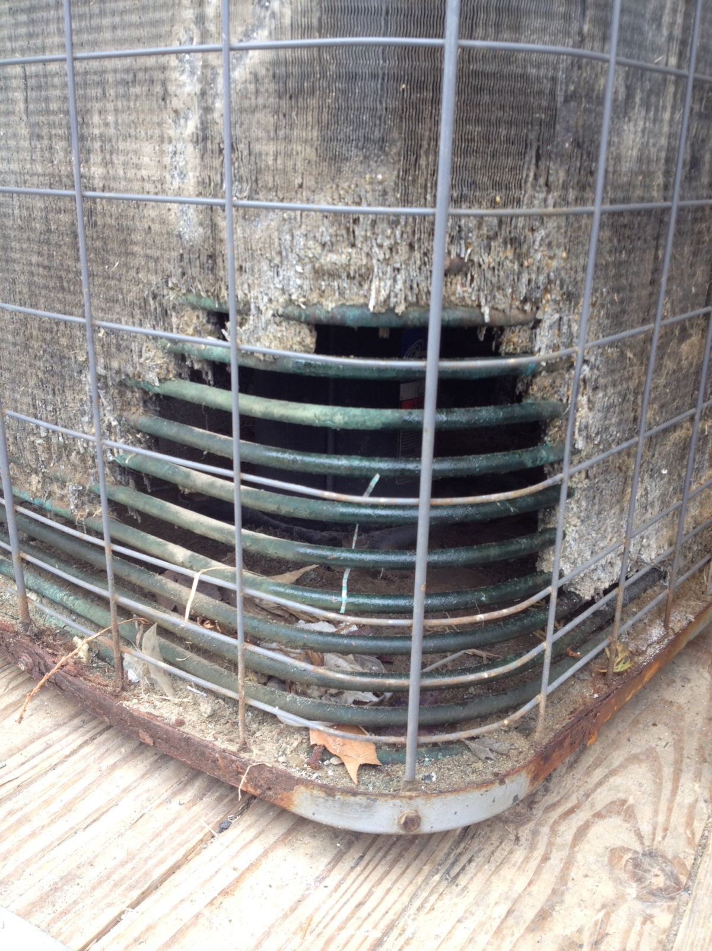
Condensing unit
The condensing unit is connected to the evaporator coil. This unit is installed by HVAC contractors on the outside of your home and filled with refrigerant gas. When the refrigerant has been cooled to a liquid by heat exchange with the exterior air, the condensing unit pumps the liquid to the evaporator coil to be evaporated into a gas once more.

Slide 10
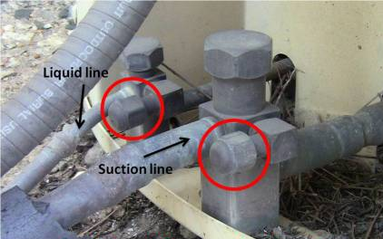
Refrigerant lines
The refrigerant lines carry a refrigerant substance to the condensing unit vaporized in the form of a gas, and return it to the evaporator coil in liquid form. These "lines" are actually narrow tubes manufactured from a durable heat- and cold-resistant metal such as copper or aluminum.

Slide 11
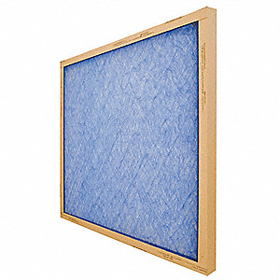
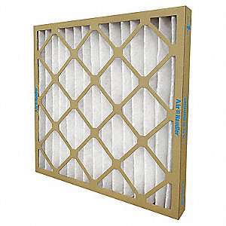
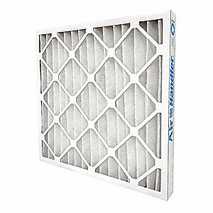
Filters
The filter is a porous device for removing impurities or solid particles from the air that passes through it.
Fiberglass MERV 5, $3
Synthetic Pleated MERV 7, $5
Synthetic Pleated MERV 8, $7

Slide 12
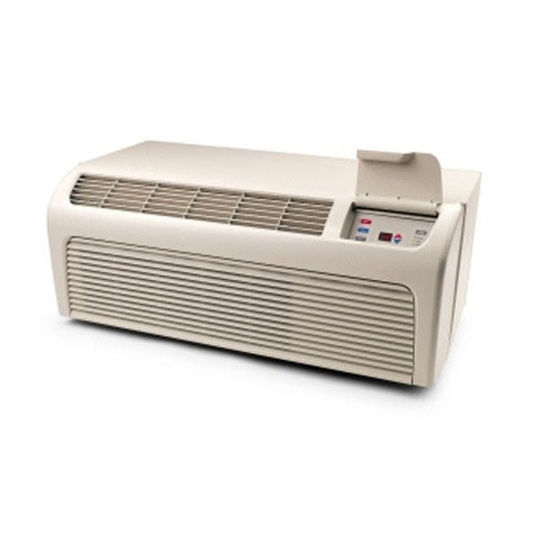
PTAC
A Packaged Terminal Air Conditioner (often abbreviated PTAC) is a type of self-contained heating and air conditioning system commonly found in hotels, motels, senior housing facilities, hospitals, condominiums, apartment buildings, add-on rooms & sunrooms.

Slide 13
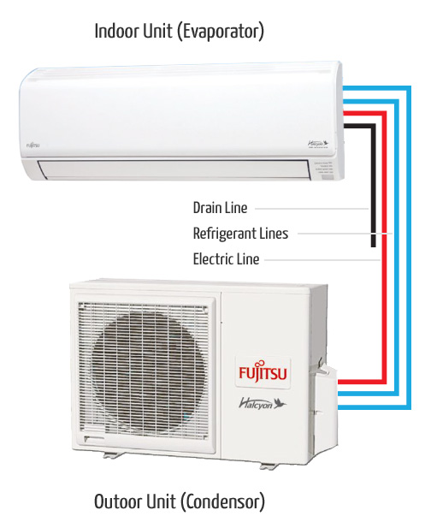
Ductless
mini-split
Mini-splits are heating and cooling systems that allow you to control the temperatures in individual rooms or spaces.
Mini-split systems have two main components -- an outdoor compressor/condenser and an indoor air-handling unit(s) (evaporator). They are easy to install usually requiring only a three-inch hole through a wall for the conduit; which houses the power and communication cables, copper tubing, and a condensation drain line, linking the outdoor and indoor units.
Mini-split heat pumps are not only great solutions for whole home or new constructions but make good retrofit add-ons to houses with “non-ducted” heating systems, such as hydronic (hot water heat), radiant panels, and space heaters (wood, kerosene, propane). They can also be a good choice for room additions where extending or installing distribution ductwork is not feasible, and energy efficient new homes that require only a small space conditioning system.

Slide 14
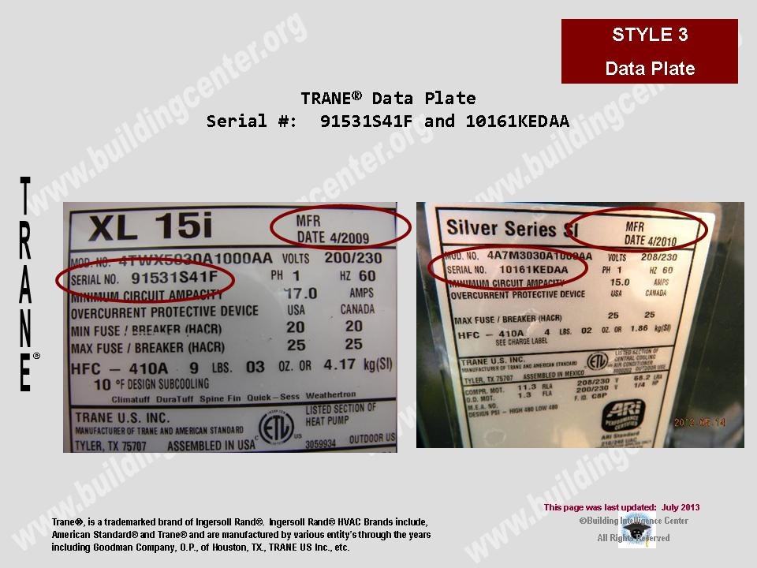
What you need to know
Manufacturer
Date
Serial Number
Refrigerant Type

Slide 15
Useful Life Estimates
Remaining Useful Life
Warranty Specifics
60 day registered extended warranty

Slide 16
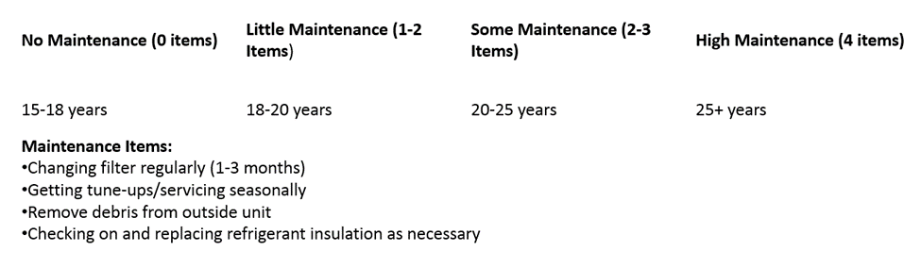

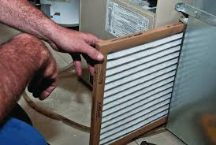
Maintenance Best Practices
Trusted quality equipment
Standardized equipment
Annual Inspections
Reliability
Serviceability
Performance

Slide 17
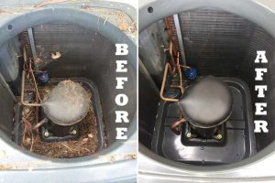
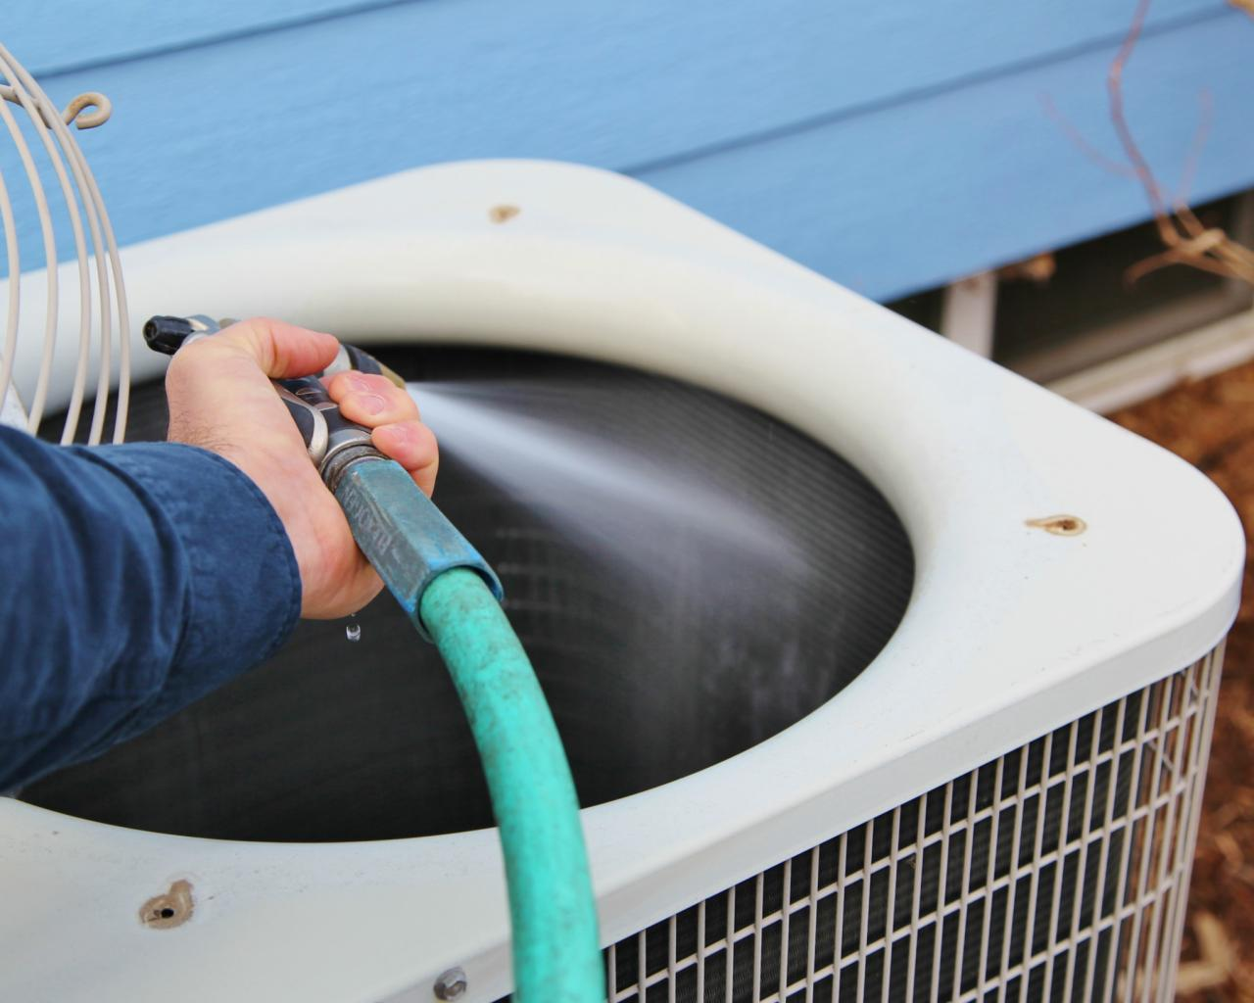
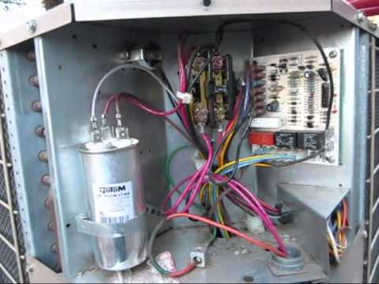
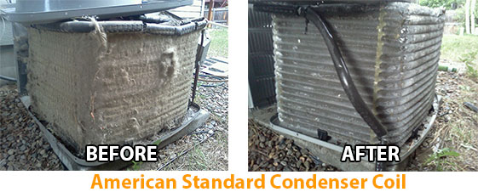
Vacuum
Low pressure hose (inside out)
Check Capacitor
Inspect Evaporator Fins
Professional Servicing

Slide 18
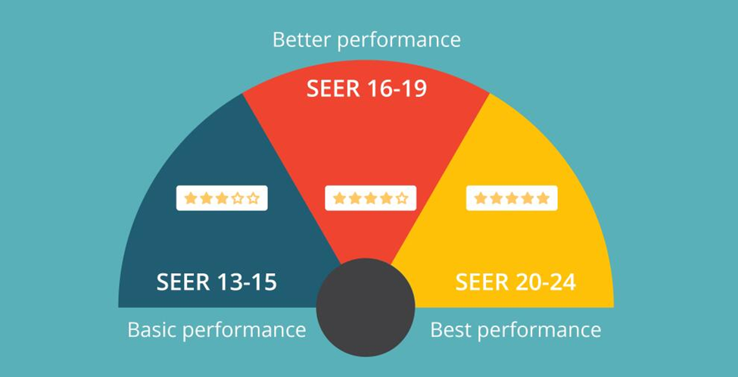
Technically Speaking
SEER- Seasonal Energy Efficiency Ratio
MERV- Minimum Efficiency Reporting Value

Slide 19
Refrigerant
Changes
USE OF R-22 refrigerant in HVAC Systems is Coming to an End
R-22 refrigerant will be 99.5% phased out in use for commercial and residential HVAC products by 2020. In 2015, consumption was reduced by 90%
Phase out dates were set for all ozone depleting substances as part of the Montreal Protocol of 1987. The EPA declared R-22 an ozone depleting substance.
Manufacturers were ordered to stop producing R-22 condensing units as of 2010
The current replacement for R-22 is R410A

Slide 20
Refrigerant Changes
Consider Your Options
If you have existing HVAC systems that use R-22 or are close to the end of their operational lifecycle you have three options.
Leave in Place: your aging system will require more maintenance and repair. The increasing cost of R-22 refrigerant as well as the parts for maintenance and repair will cause longer downtime and higher maintenance expenses.
Convert: try and convert to an alternative refrigerant. Some examples of alternative refrigerants are (R-407c, R-421a, R-438A, or R422B) These refrigerants are not designed for a system with R-22, and operating efficiency and reliability will be greatly affected.
Replace: for peak performance and immediate and long term return on your investment, transitioning to new equipment with today’s refrigerant sooner rather than later makes the most sense.

Slide 21
Refrigerant Changes
RISK AND REWARD OF REPLACEMENT
RISKS;
Alternative refrigerants result in reduced efficiency that can negatively impact unit performance and the quality of your residents’ comfort. Alternative refrigerants will also increase your residents’ energy consumption which can have an impact of their utility costs.
Some refrigerants can create serious problems in older equipment including compressor oil losses, increased flammability and system instability.
Ongoing regulation threatens the long term viability of replacement of drop in solutions.
Counterfeit refrigerants are a growing issue and compromise efficiency reliability safety and the environment
REWARDS;
Energy Efficiency: new systems are designed to be more energy efficient. Installing one will reduce energy consumption and increase your residents’ comfort and satisfaction.
Warranty: new systems fall under the manufacturer’s registered warranty typically covering your parts cost for 10 years from the date of installation.
Maintenance: newer systems require much less maintenance, therefore decreasing the budget implications of unplanned maintenance expenses freeing you from service and repair headaches and creating more resident satisfaction.

Slide 22
THANK YOU FOR YOUR TIME
ANY QUESTIONS CAN BE DIRECTED TO;
Zach Howell
Zach@aminstitute.net
503-354-7602

